Slide 1

Exploratory Data Analysis of Bank01 Yog Chaudhary ADTA 5410

Slide 2
Agenda
Introduction
EDA Highlights
Recommendations
Concussion

Slide 3

Overview of Bank01
87681 Observation (Instances) and 20 features
12 Products Sales Information ( RFM1 To RFM12)
7 Customer Information.
Age, Gender, Homeowner, Home Value, Income and retirement in the area
INT_TGT ( Target Variable)
Reflecting the correlation between it and the input variable
Reflecting the performance of input variables.

Slide 4
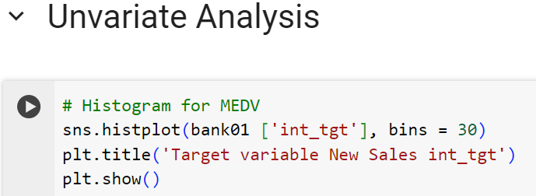
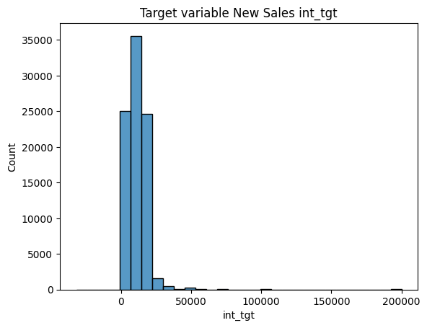
Target Variables New Sales int_tgt
Insight:
Int_tgt leans heavily towards smaller amounts.
High sales targets are common, very high targets are rare. Focus on boosting low-target interactions and explore the potential of the few high-target accounts.
Strategic Recommendations:
To engage customers with low interactions, use personalized messages, special deals, and rewards programs to boost their activity and sales. For customers with high interactions, find out why they're active and use that knowledge to sell more to them and to increase other customers' activity, aiming to grow sales overall
These recommendations based on the assumption that int_tgt reflects some measure of customer sales targets. Increasing engagement with the largest segment and capitalizing on the high engagement of the smaller segment could be key strategies for sales growth.

Slide 5
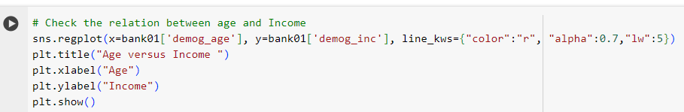
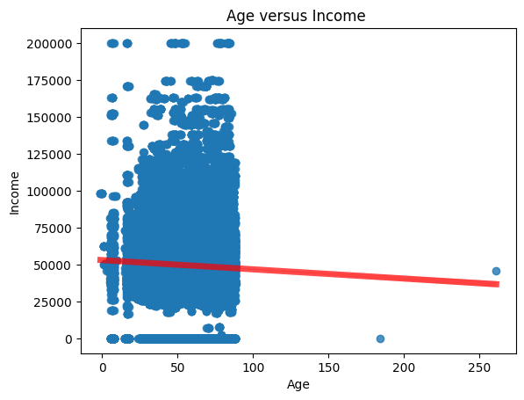
The Relation between Age and Income
Insights:
The scatter plot with a regression line is a slight negative correlation between age and income, as indicated by the downward slope of the line.
The data points are densely clustered at the lower age range with varying incomes, showing that a wider range of incomes is present among the younger demographic.
Some outliers are present, especially high incomes that do not follow the general trend.
Strategic Recommendations:
Further analysis might be needed to identify other demographic factors that more strongly correlate with income.
The presence of high-income outliers suggests there could be a niche market segment that could be targeted with premium services or products.

Slide 6
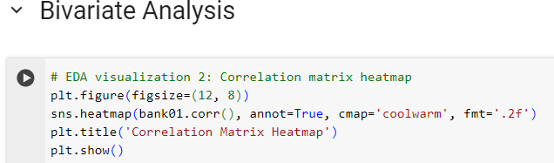
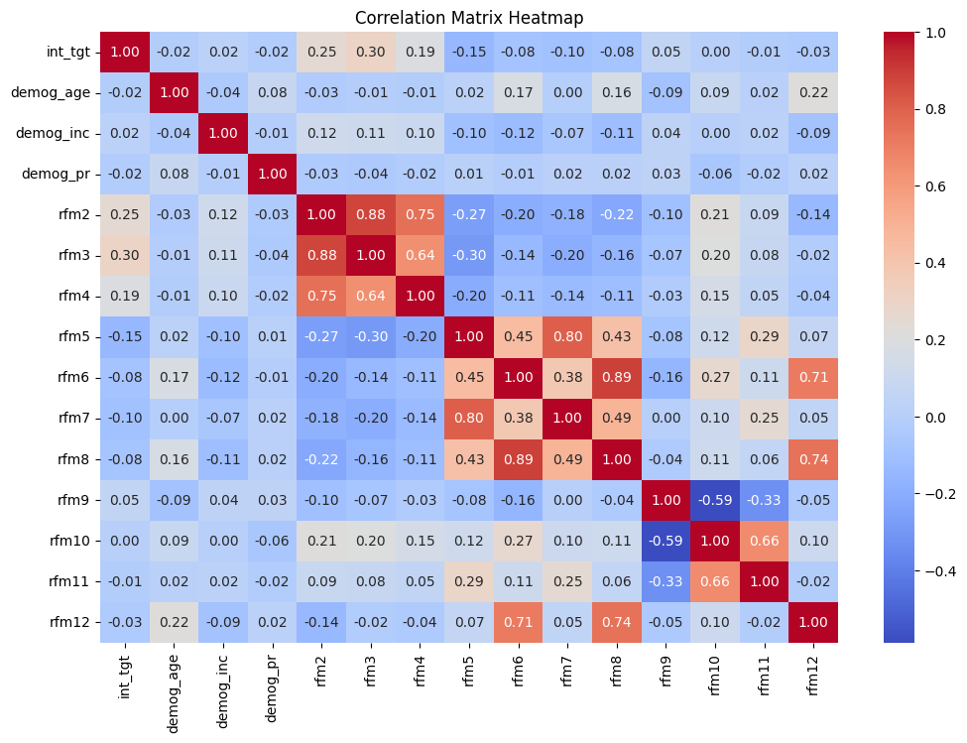
Correlation Matrix heatmap
Insights:
The target variable int_tgt seems to have the strongest positive correlation with rfm3, rfm6, rfm8, and rfm12. These particular RFM metrics could be indicators of customer behaviors that are aligned with the bank's interests.
There are strong positive correlations amongst certain RFM variables, such as between rfm2 and rfm3, rfm6 and rfm8, and others. This inter-correlation suggests that these RFM metrics may be influenced by similar customer behaviors or characteristics.
Demographic variables like demog_age and demog_inc show weak correlations with the target variable int_tgt, suggesting that age and income alone may not be strong predictors of the target variable.
Strategic Recommendations:
Since rfm3, rfm6, rfm8, and rfm12 show the strongest correlations with int_tgt, the bank should analyze these metrics further to understand the behaviors they represent. Marketing initiatives could then be designed to enhance these behaviors.
For customers with high rfm3, rfm6, rfm8, or rfm12 scores, the bank could develop targeted offers that encourage the continuation or increase of the behaviors these scores represent.
It is important to conduct further analysis to understand the nature of the RFM metrics that correlate with int_tgt. For instance, if rfm3 represents recent interactions with the bank, strategies could be developed to keep customers engaged regularly.

Slide 7
CONCLUSION
All are these strategies are built in the findings from the exploratory data analysis
By correlating these insights with the INT_TGT variable, which measures the intensity of sales interactions, we can derive meaningful strategies. The data suggests an untapped potential in nurturing low-interaction customers to deepen their engagement, possibly through personalized outreach and bespoke financial solutions.
Our business strategies with the data-driven insights from the dataset, position ourselves to foster stronger customer relationships and drive new sales. Our analysis not only illuminates the current state of customer interactions but also paves the way for innovative approaches to enhance the banking experience and grow our financial services.

Slide 8


